Slide 1
Operationalizing Intersectionality Across the Data Value Chain
12 March 2025 | 12:30PM – 2:00 PM | Salvation Army, Lower Level

Slide 2
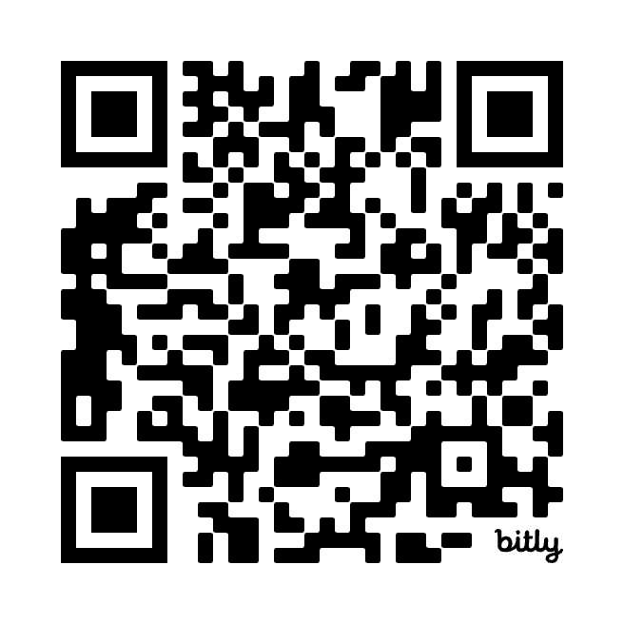
WELCOMING REMARKS
Krista Jones Baptista
Executive Director, Data2X
Scan to join newsletter:
Notes:
Add QR code to sign up for newsletter

Slide 3
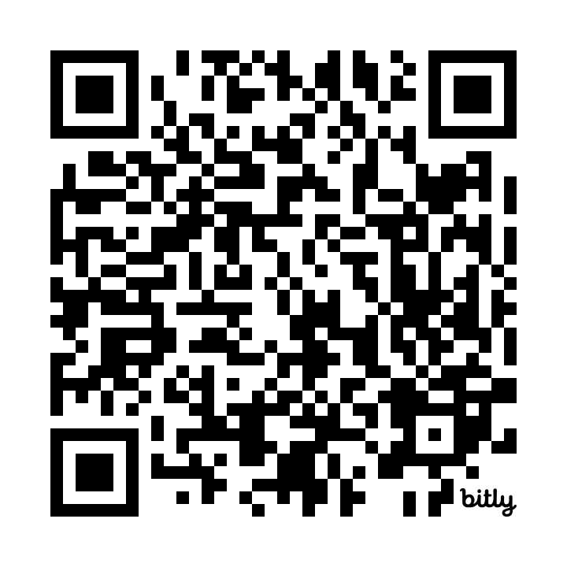
KEYNOTE SPEAKER
Papa Seck
Chief of Research and Data Section,
UN Women
Scan to join newsletter:
Notes:
Add QR code to sign up for newsletter

Slide 4
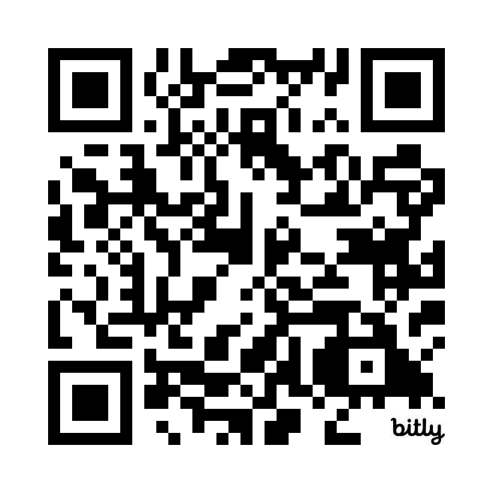
SCENE-SETTING
Shaida Badiee
Managing Director, Open Data Watch
Scan to join newsletter:
Notes:
Add QR code to sign up for newsletter

Slide 5
INTERSECTIONALITY IN DEVELOPMENT DATA:
Understand the experiences and challenges faced by individuals who occupy multiple and intersecting group identities to promote inclusive data systems globally.​

Slide 6
THE CASE FOR MORE INTERSECTIONAL DATA
Available Data Illuminate Critical Development Challenges But…
1 in 3
26.5%
129 million
women have experienced gender-based violence¹
of parliamentarians are women²
girls around the world are out of school⁴
~ 800
67
267.6
women died per day from preventable pregnancy and childbirth related causes in 2020³
countries have national laws criminalizing same-sex relations⁵
years away from achieving gender parity in economic participation and opportunity⁶
…Intersectional Data is Needed to Understand Unique Challenges
Intersectional and nuanced data will uncover patterns, root causes, differentiated experiences, compounded disparities, and underlying factors to inform targeted and impactful interventions.
Source: 1. WHO Fact Sheet;2. UN Women Fact Sheet; 3. WHO Fact Sheet; 4. UNICEF Girls’ education ; 5. Human Rights Watch, OUTLAWED; 6. World Economic Forum, 6 surprising facts about global gender pay gaps

Slide 8
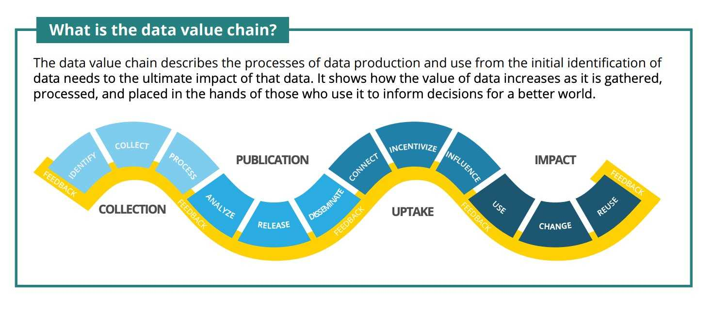
INTERSECTIONALITY ACROSS THE DATA VALUE CHAIN

Slide 9
Engagement with civil society in Morocco strengthens data collection for violence against women and girls (VAWG)
COLLECTION
Collection covers all steps in the creation of raw data to answer a question and solve a problem.
Intersectionality elevates the quality and accuracy of raw data and resulting analysis.
KEY CONSIDERATIONS:
Meaningful engagement for better data collection
Building a better ecosystem of data sources
Shifting the balance of data ownership
Engagement with civil society in Morocco strengthens data collection for violence against women and girls (VAWG)

Slide 10
The United Kingdom excels in publishing disaggregated data on sex and gender identity in open formats
PUBLICATION
Publication involves the processes of making raw data available for public access.
Intersectionality helps produce insights that address needs of those the data are about.
KEY CONSIDERATIONS:
Intersectional analysis to capture meaningful insights
Publishing data in accessible formats for equitable use
Data stewardship to guide inclusive and equitable data production

Slide 11
UPTAKE
Uptake is the process of connecting users with data and facilitating their use.
Intersectionality involves a system-wide commitment to complete the data landscape.
KEY CONSIDERATIONS:
Connecting users to intersectional data
Building capacity for intersectional data use
Creating incentives to prioritize intersectionality
An action plan to finance and build capacity for the uptake of disaggregated disability data in Kenya

Slide 12
Using data to identify and address racial disparities related to maternal health in Brazil
IMPACT
Impact is achieved when data inform a decision or alter a condition and thereby improve wellbeing.
Intersectionality guides more effective impacts through deeper understanding of inequality.
KEY CONSIDERATIONS:
The importance of who benefits
Ethical considerations and monitoring
Strengthening feedback loops and building trust and demand

Slide 13
Standardize intersectional data practices: Establish standards and guidelines for the production and governance of intersectional data to initiatives.
Mobilize resources: Secure adequate funding and technical assistance as part of requirements to prioritize an intersectional approach to data
Develop case studies: Identify best practices and create opportunities to facilitate learning between practitioners to build and maintain momentum.
Collaborate across other movements: Maintain intersectionality as a high priority within other initiatives such as citizen-generated data and data feminism.
CALL TO ACTION

Slide 14
MEET THE PANELISTS
Elizabeth Lockwood
CBM Global Disability Inclusion
Laura Soto Arroyave
Ministry of Foreign Affairs, Colombia
Luiza Drummond Veado
United Nations Development Programme (UNDP)

Slide 15
CLOSING REMARKS
Amy Pennington
Senior Program Officer for Gender Data & Evidence, Gates Foundation

